Slide 1


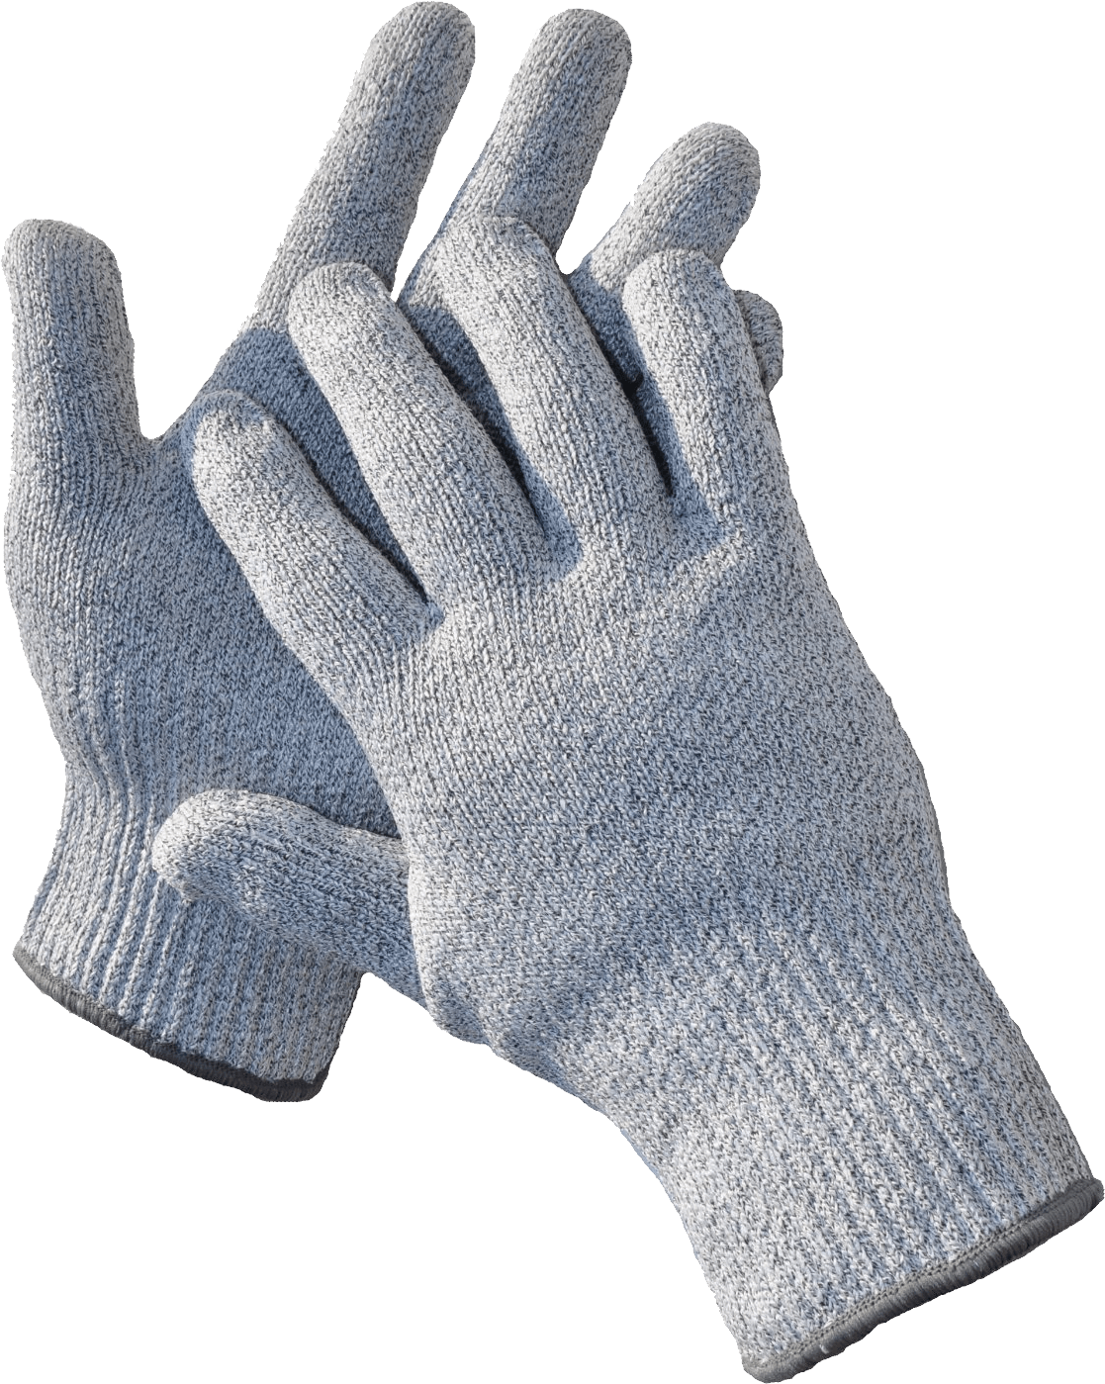

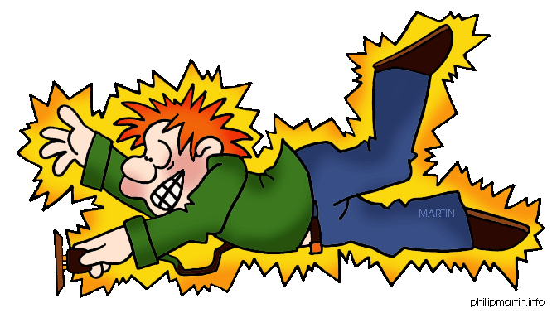

SHOCKLOVES
BIG HANDS TOWARDS
WOMENS SAFETY

Slide 2




The Team
Shivam Sharma
Konark Sharma
Vedangi Aggarwal
Mehak Bhatia
Iind Yr, Cse-Ibm
Iind Yr, Cse-IBM
Iind Yr, Cse-IBM
Iind Yr, Cse-IBM

Slide 3

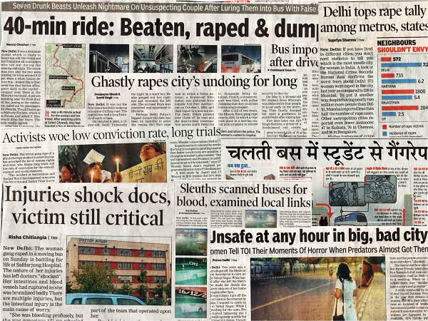

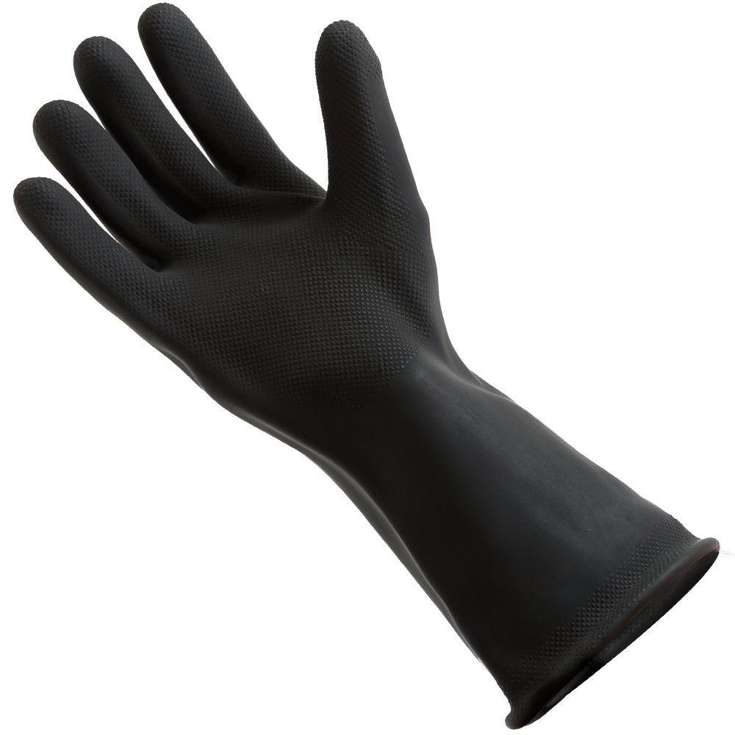

Slide 4


BATHROOM BREAKS
Do not say the b-word
Sign out (3 sign outs per marking period)
Use the pass
Bring it back
1
2
3
4

Slide 5


FIRE DRILL
1
Push chairs in
Lights out
Single file, silent line
Proceed toward the woods
Pass the playground on the right
Count off
2
3
4
5
6

Slide 6

EVACUATION
Push chairs in
Lights out
Single file, silent line
Walk toward the high school
Pass the playground on the left
Proceed to new gym
Count off
1
2
3
4
5
6
7

Slide 7



SHELTER IN PLACE
1
2
3
Door closed and locked
Windows covered, closed, and locked
Students may only move around the building escorted by an adult

Slide 8


LOCK DOWN
Lights out
Door locked
Hide under the tables
Chair pulled toward you
No talking
1
2
3
4
5

Slide 9


WEATHER EMERGENCY
1
2
Know the safety zone
Move quickly and quietly to the safety zone

Slide 10
Customize this Template
Template Editing Instructions and Feedback

